Slide 1

Food Truck management system
Group 11 :
Mary ann chev
Ben Willetts
Brent coutts
Rony azrak

Slide 2
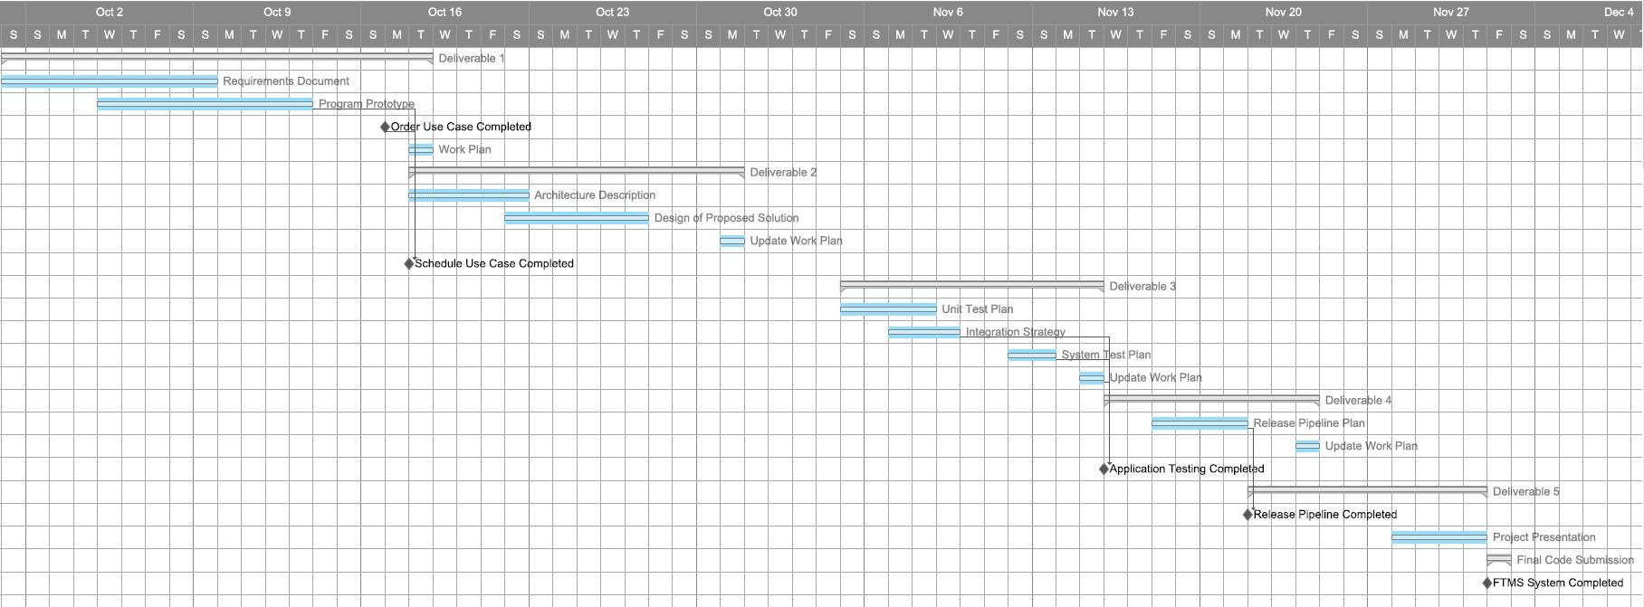
Work Plan Gantt Chart Part 1

Slide 3
Work Plan Gantt Chart Part 2

Slide 4
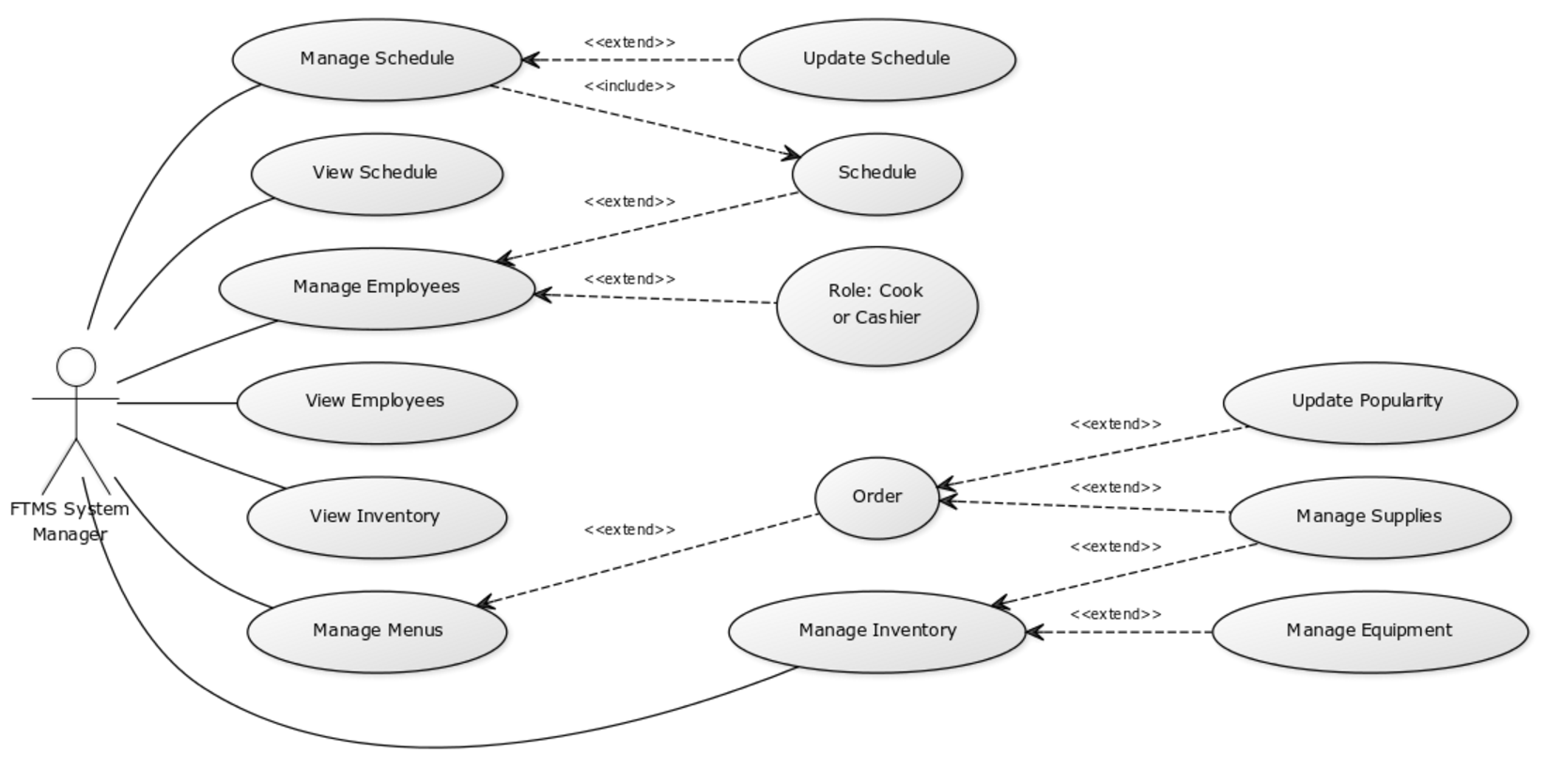
Use Case diagram

Slide 5
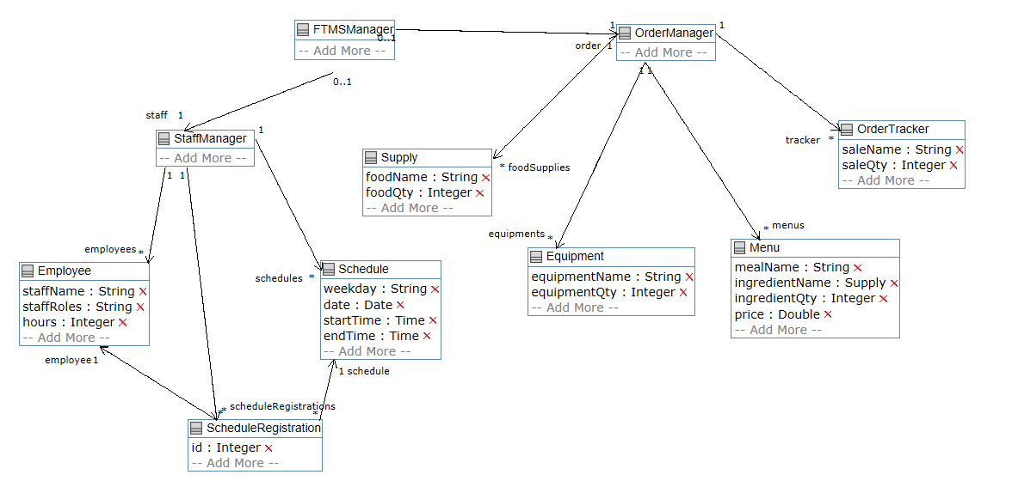
Domain model

Slide 6
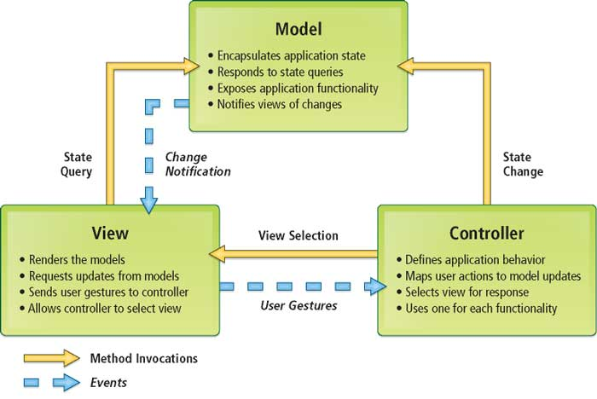
Design architecture (mvc type)
http://www.esri.com/news/arcuser/0609/graphics/aspnetmvc_1_lg.jpg

Slide 7
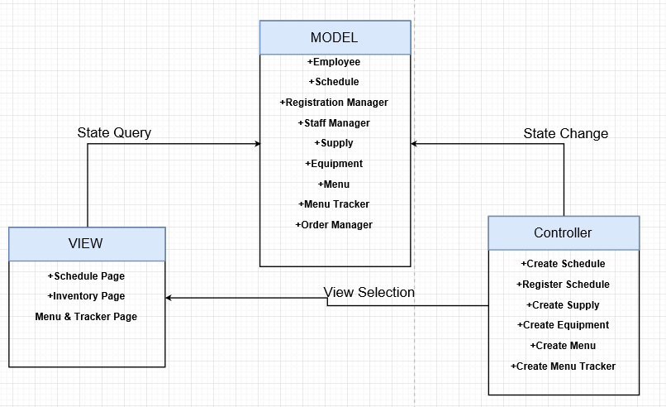
Project MVC architecture

Slide 8
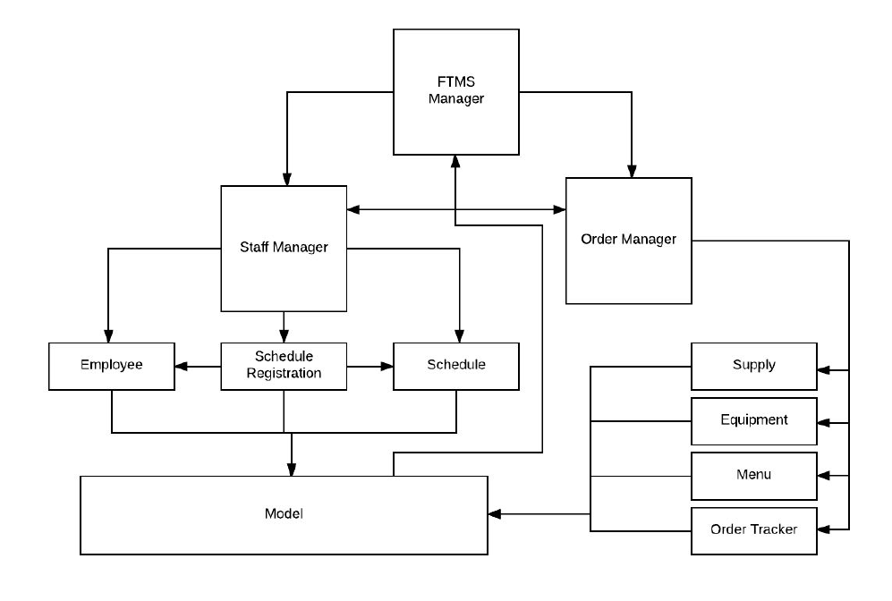
Architecture of the FTMS

Slide 9
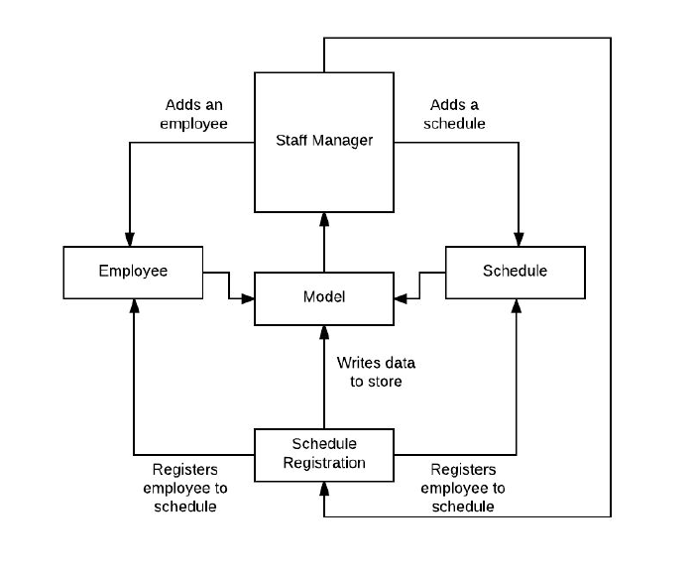
Architecture of the staff manager

Slide 10
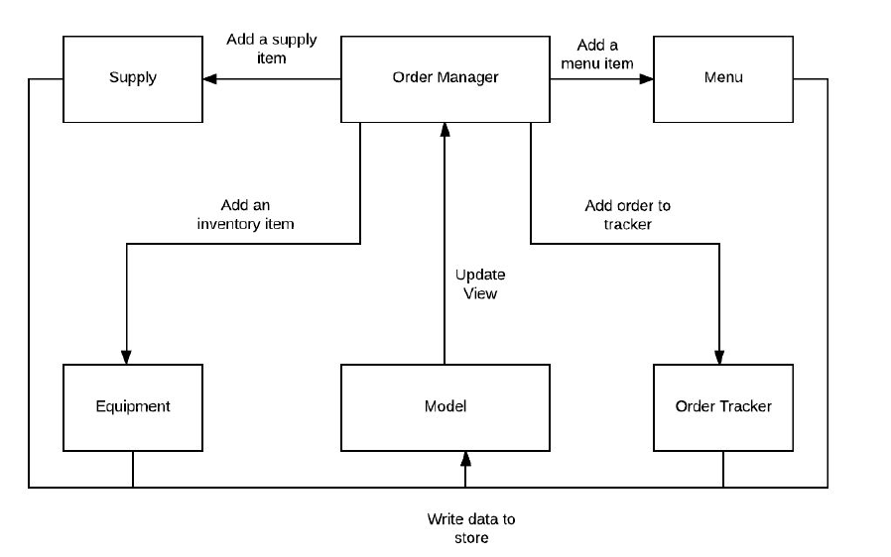
Architecture order manager

Slide 11
Android Modifications

Slide 12
Testing
Integration Tests
System Tests
Unit Tests

Slide 13

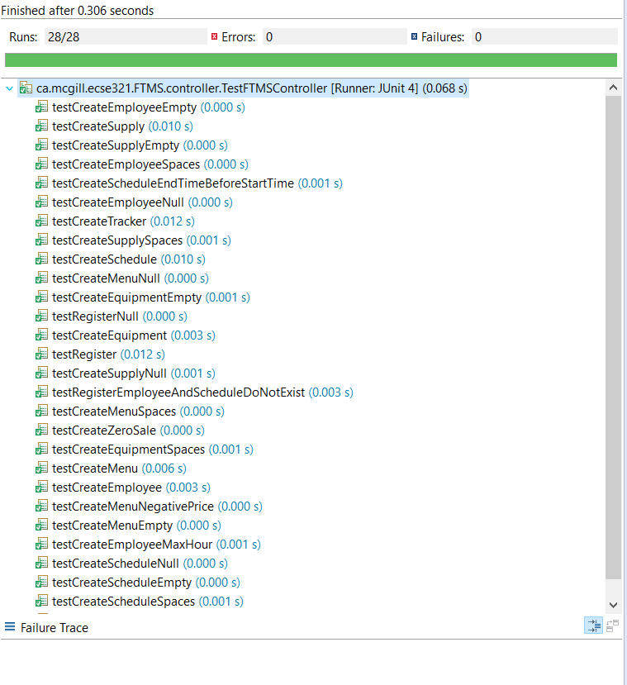
Quality Assurance : Unit & integration test:
Java : Junit test:
- Controller
- Persistence
Android: No unit test same as the JAVA portion
PHP: PHP unit Test
Integration Tests:
- Conducted for each component of the app once the used cases were completed

Slide 14
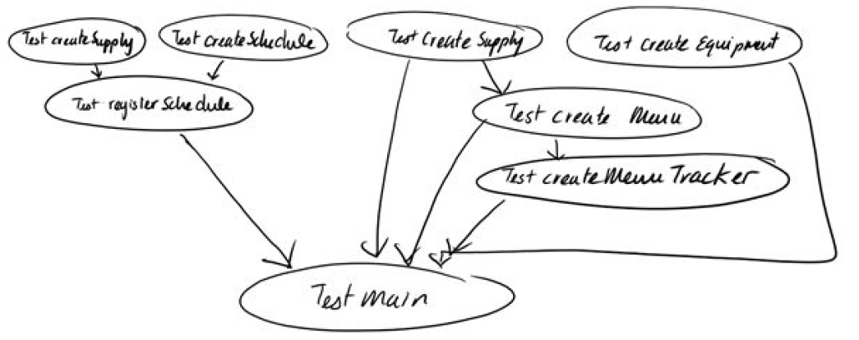
Bottom-Up Integration Strategy

Slide 15
Quality Assurance: System Tests
Desktop App ➔ Windows, macOS, Linux
Android App ➔ Multiple Android phone models
Web App ➔ Common Browser Applications

Slide 16
Release pipeline
Integration
Build
Deployment

Slide 17
Integration

Slide 18
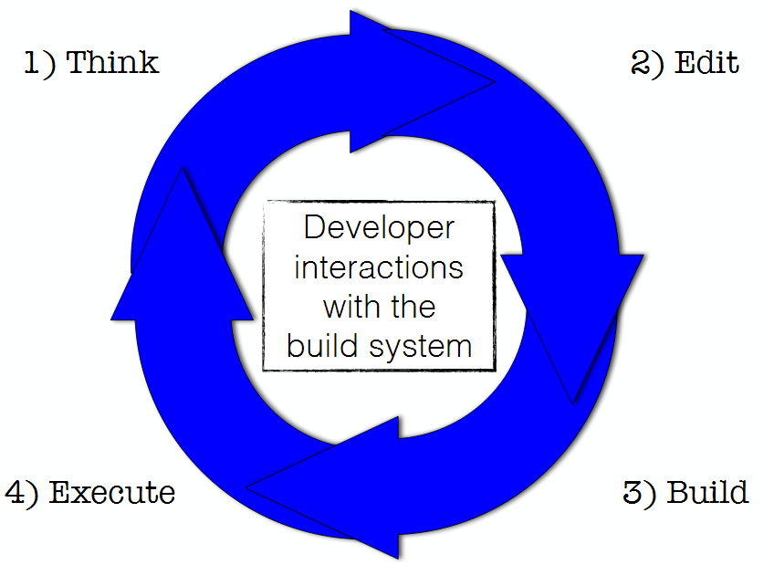
Build
Continuous Integration Build System
Travis-CI ➔ Desktop ➔ Jar file
Gradle ➔ Android ➔ APK file
XAMPP to host local web server

Slide 19
Deployment
Desktop ➔ packaged as JAR file
Ready for execution
Android ➔ exported as an APK file
Loaded to the phone via laptop or desktop
Web ➔ Hosted on a web server
Accessible via a link to the website

Slide 20
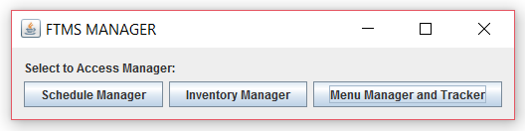
Desktop/laptop platform start-up view
All managers are implemented so that they have several views

Slide 21
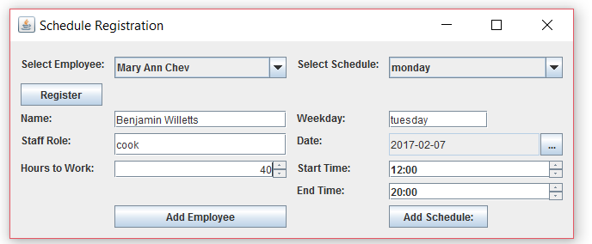
Desktop/laptop platform schedule manager view

Slide 22
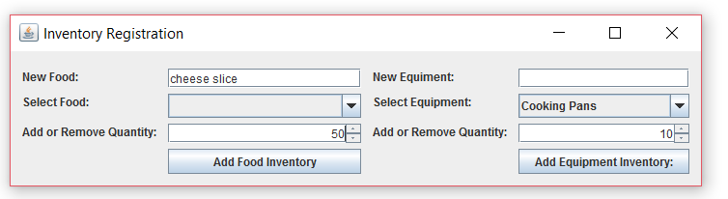
Desktop/laptop platform inventory manager view

Slide 23
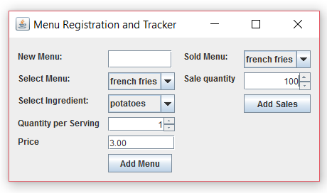
Desktop/laptop platform menu manager view

Slide 24
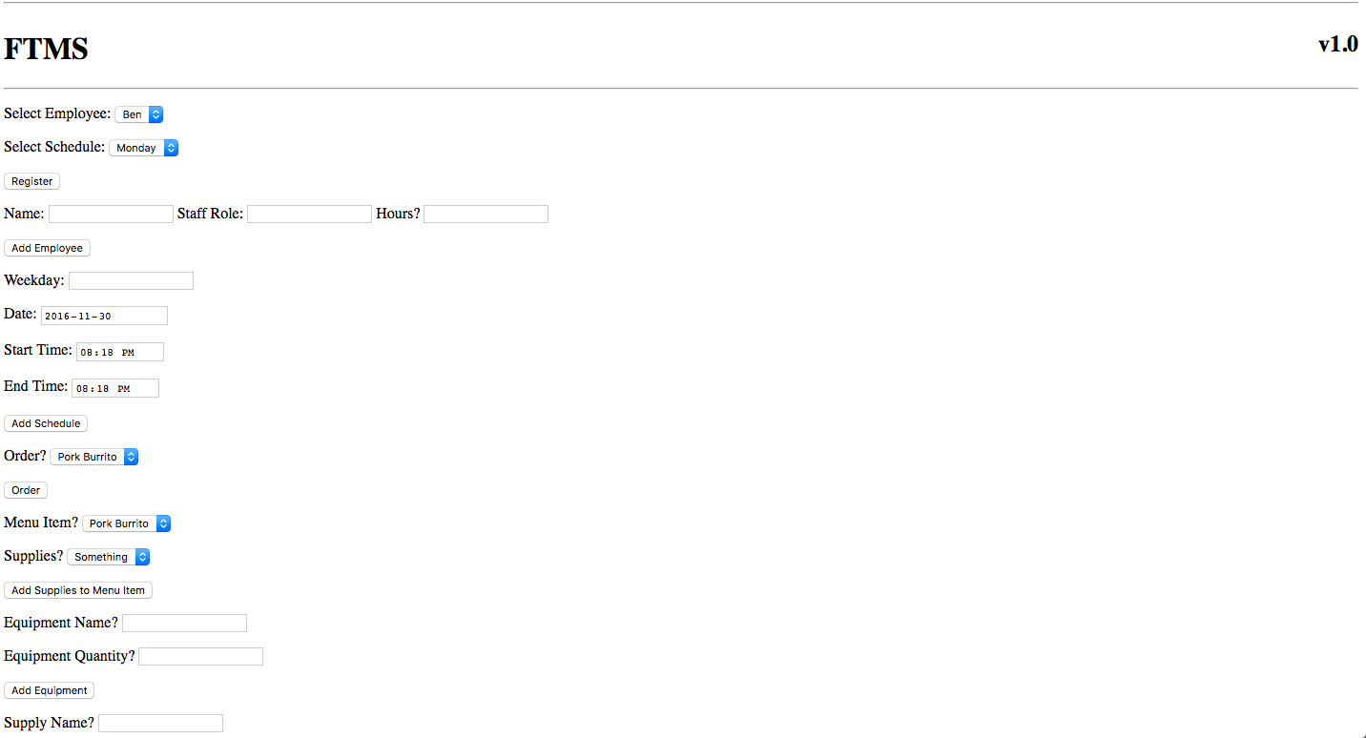
PHP View

Slide 25
Live Demo

Slide 26
Conclusion
Architecture
MVC Design Pattern
Singleton Design Pattern
Testing
Unit Testing
System Testing
Release Pipeline
Integration
Build
Integration Testing
Deployment
Live Demo
Showcased our application on the Android platform.

